Slide 1


Slide 2
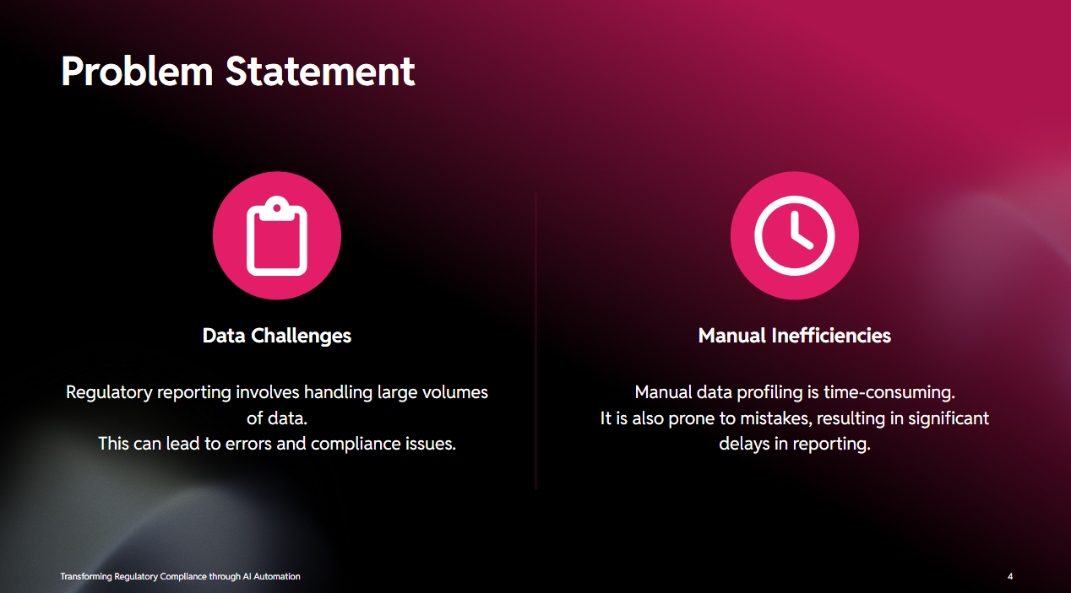

Slide 3
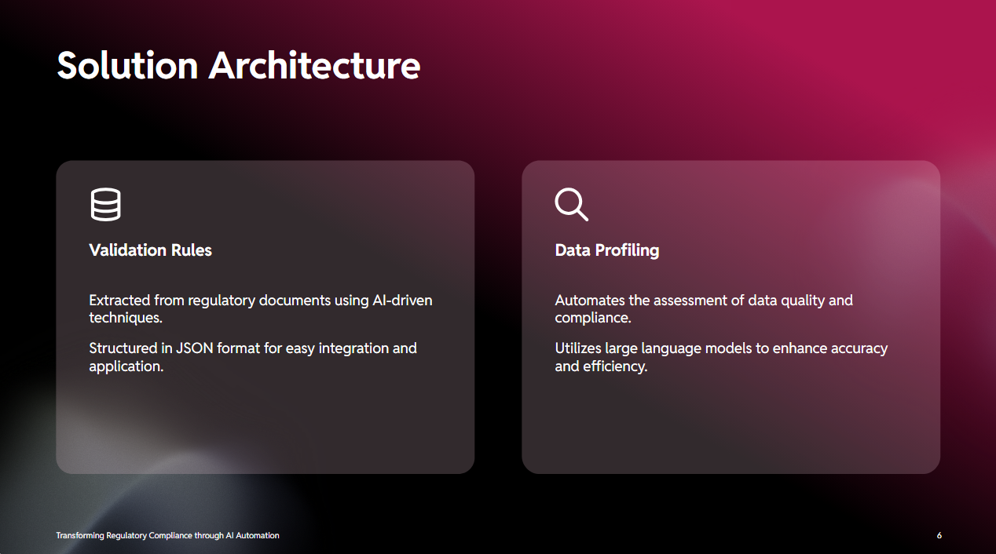

Slide 4
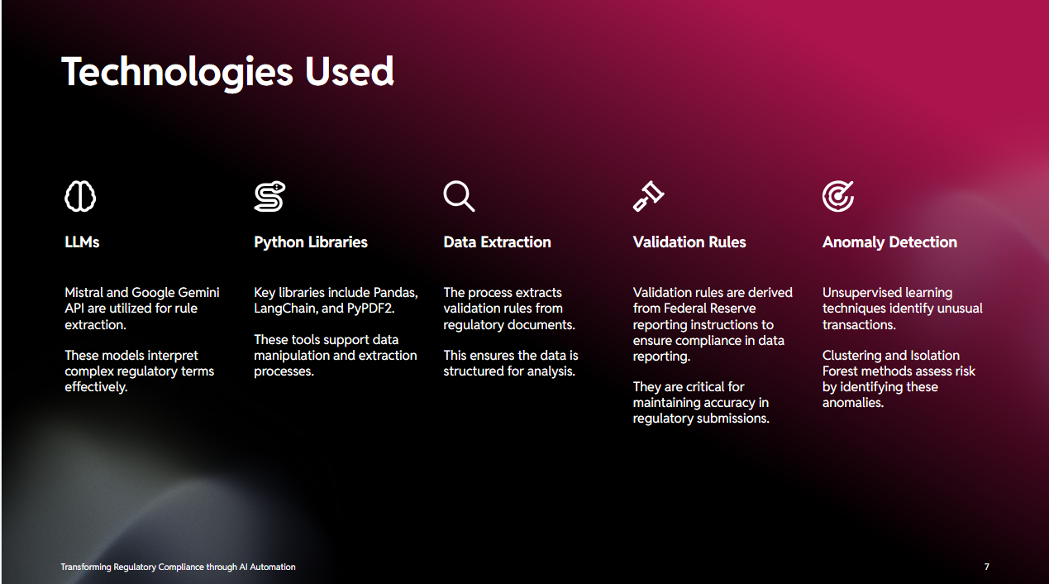

Slide 5
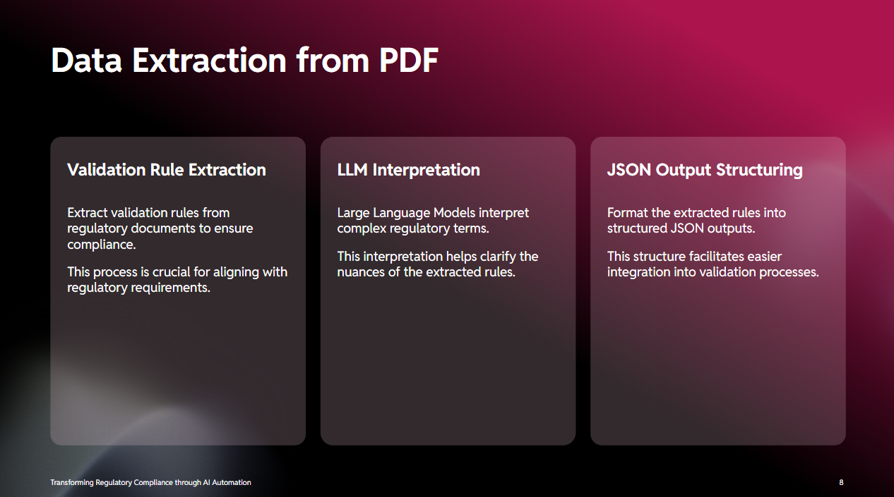

Slide 6
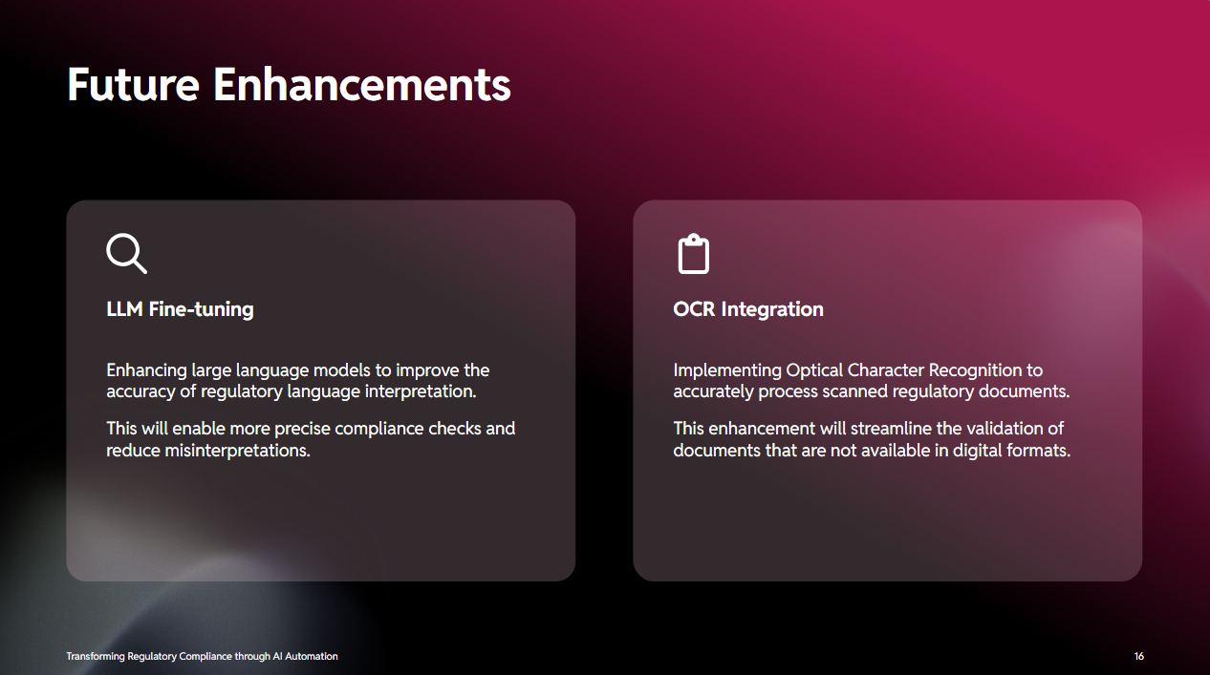

Slide 7
THANK YOU
Presented By:
Saurabh Maurya (saurabh.k.maurya@wellsfargo.com)
Raunak Kumar (raunak.kumar@wellsfargo.com)
Shubham Mundhra (shubham.mundhra@wellsfargo.com)

